Slide 1
JACKSONVILLE HARBOR DEEPENING STUDY WATER QUALITY MODELING
Presented by:
Michael Kabiling, Ph.D., P.E., C.F.M. Senior Engineer, Taylor Engineering, Inc.
October 22, 2012

Slide 2
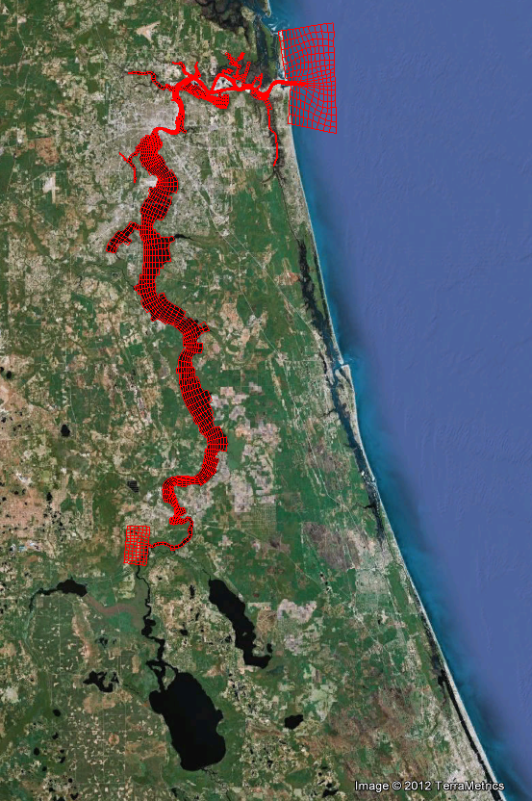
USACE EFDC-CEQUAL-ICM Model Mesh
model domain comprises 2,707 curvilinear horizontal water cells
six equally divided layers in the vertical direction
model variables are
water surface elevation
velocity
salinity
AIWW
Atlantic Ocean
St. Johns River
Crescent Lake
Lake George

Slide 3
EFDC Model Calibration (Salinity)
Stations | Calibration Period (1997) |  | Verification Period (1998)
 | Correlation Coefficient | RMSE (ppt) | Correlation Coefficient | RMSE (ppt)
Dames Point (Surface) | 0.911 | 2.686 | 0.948 | 2.385
Dames Point (Bottom) | 0.874 | 4.105 | 0.883 | 3.896
Acosta Bridge (Surface) | 0.899 | 2.113 | 0.972 | 1.099
Acosta Bridge (Bottom) | 0.886 | 2.433 | 0.974 | 1.033
Buckman Bridge (Surface) | 0.787 | 0.986 | 0.898 | 0.419
Buckman Bridge (Bottom) | 0.962 | 1.250 | 0.850 | 0.538
Correlation Coefficient — ability to predict trend (~ 1.0 for perfect model)
RMSE — indication of model accuracy (~0.0 for perfect model)

Slide 4
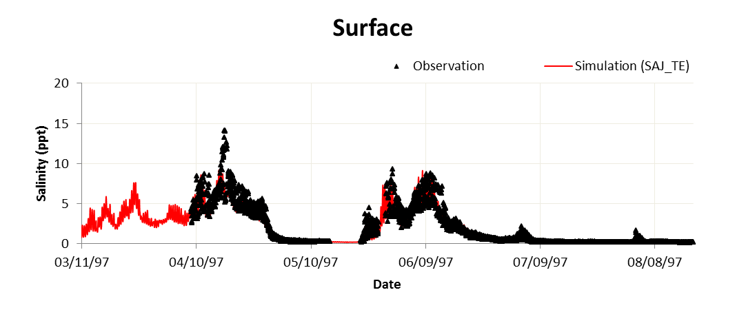
EFDC Model Calibration (Buckman Br.)

Slide 5
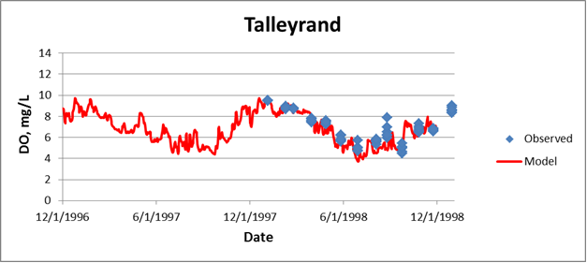
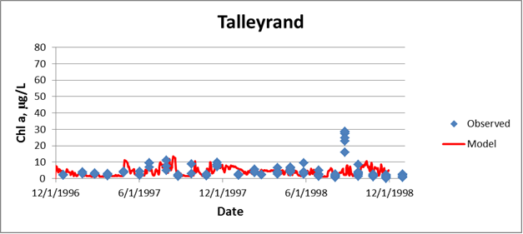
CE-QUAL-ICM Model Calibration
DO Statistic | Refined-Grid Model
R² | 0.61
RMSE, mg/L | 1.11
Chl-a Statistic | Refined-Grid Model
R² | 0.50
RMSE, µg/L | 11.49

Slide 6
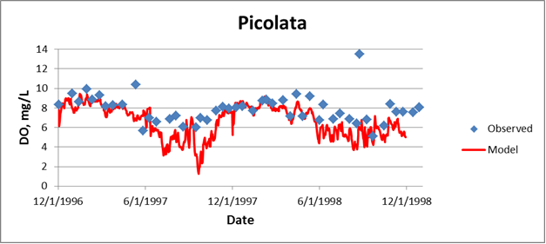
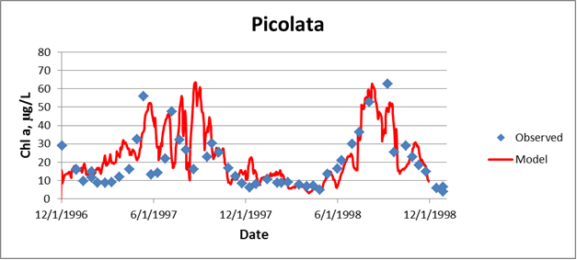
CE-QUAL-ICM Model Calibration
DO Statistic | Refined-Grid Model
R² | 0.61
RMSE, mg/L | 1.11
Chl-a Statistic | Refined-Grid Model
R² | 0.50
RMSE, µg/L | 11.49

Slide 7
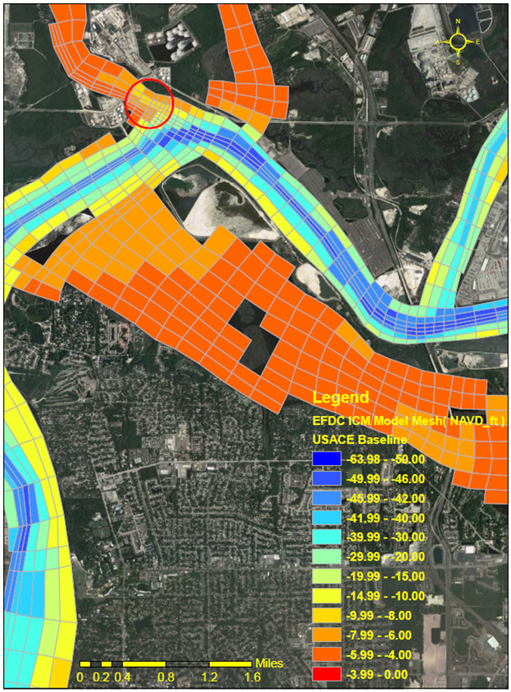
Model Challenges
Production Runs
USACE Baseline
50-ft dredge
EFDC-TMDL model has model instabilities for production runs
Model re-runs with smaller time steps

Slide 8
GRR Water Quality Modeling
USACE contact:
Steven Bratos
Steven.M.Bratos@usace.army.mil

Slide 9
GRR Water Quality Modeling
Discussion

